Slide 1
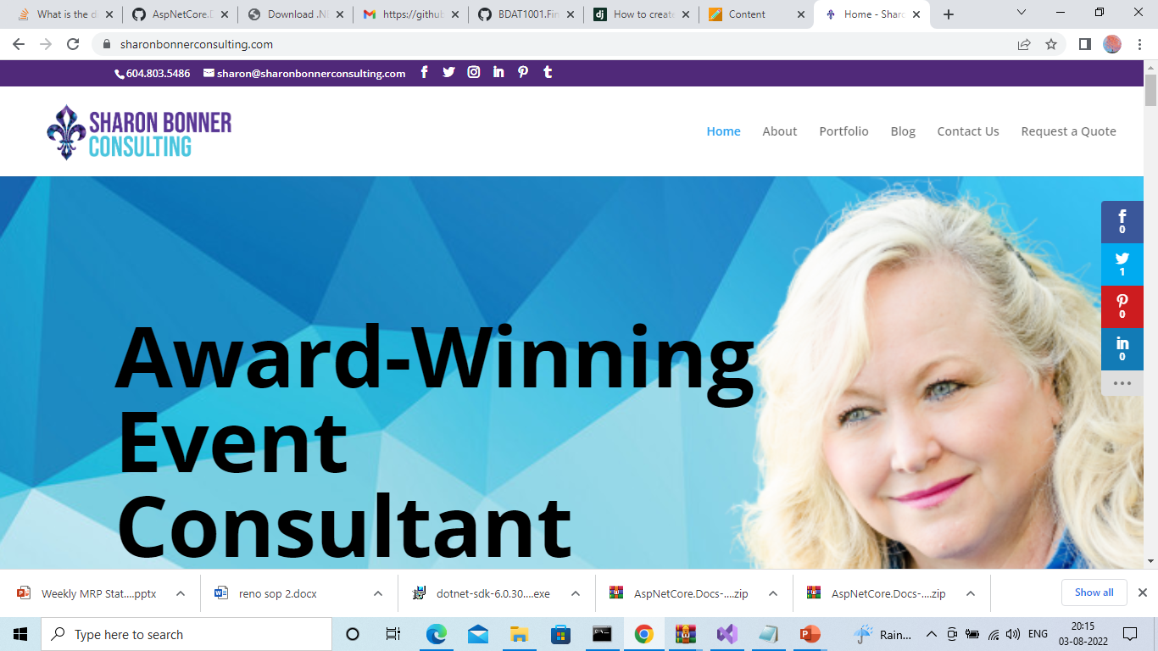
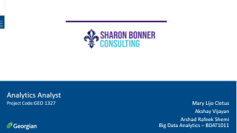
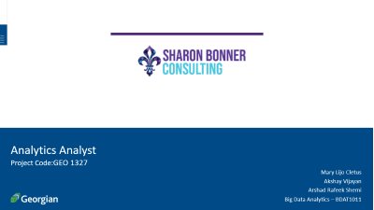
Analytics Analyst
Project Code:GEO 1327
Mary Lijo Cletus
Akshay Vijayan
Arshad Rafeek Shemi
Big Data Analytics – BDAT1011

Slide 2
Team Profile
Akshay Vijayan
Arshad Rafeek Shemi
Mary Lijo Cletus
Developer
Business Analyst
Data Analyst
Data analysis and data visualization
Managing proper communication between client and the team,
Data analysis
Managing cleaning and developing solutions from data
Development and testing

Slide 3
Data Scrapping
As part of Analytics analyst project we have scraped data from different companies in the similar field.
We used python for scraping the data

Slide 4
Data Sources
https://imaginethatevents.ca/vancouver-event-planners-blog/
https://www.pibc.bc.ca/consultant-listings
https://www.eventective.com/toronto-on/elite-event-consultants-378289.html
https://www.spectraeventgroup.com/

Slide 5
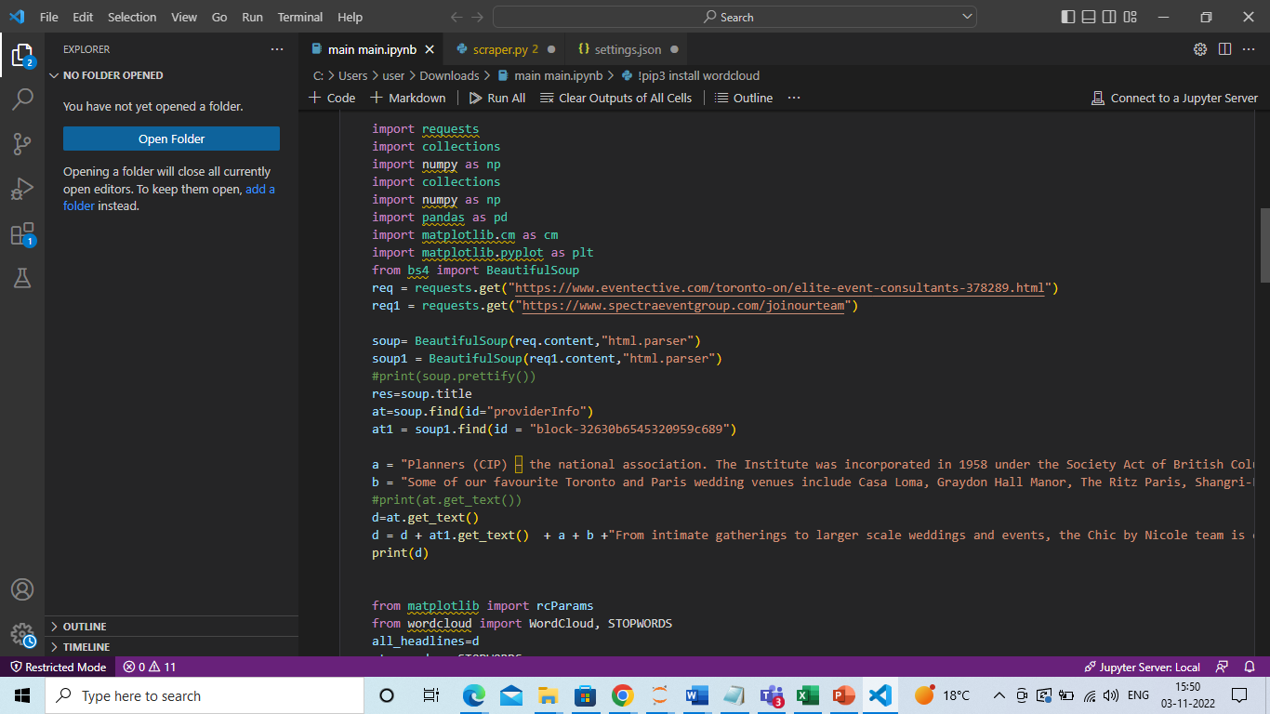
Python Web Scrapping Code

Slide 6
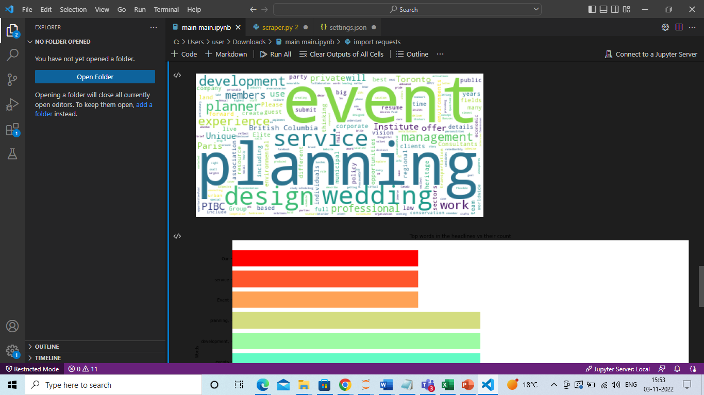
Word Cloud For SEO Keywords

Slide 7
Suggestions
We can use the highlighted keywords for SEO Keyword Optimization
Event
Planning
Service
Design
Wedding
British Columbia
Experience
Planner
Development

Slide 8
Thank you

